Slide 1
Unit 1
Introduction to Server-Side Development
-Binayak Maharjan

Slide 2
1.1 Overview of Web-I

Slide 3
1.2 What is HTTP?
HTTP stands for “Hypertext Transfer Protocol.”
It is a set of rules for sharing data on the World Wide Web (WWW).
When you visit a website, HTTP helps your browser request and receive the data needed to display the web pages you see.
It is a fundamental part of how the internet works, making it possible for us to browse and interact with websites.
Basic Structure: HTTP forms the foundation of the web, enabling data communication and file sharing.
Web Browsing: Most websites use HTTP, so when you click on a link or download a file, HTTP is at work.
Client-Server Model: HTTP works on a request-response system. Your browser (client) asks for information, and the website’s server responds with the data.
Application Layer Protocol: HTTP operates within the Internet Protocol Suite, managing how data is transmitted and received.

Slide 5
1.2 HTTP Request Message
An HTTP Request Message is the communication sent from a client (e.g., browser) to a server to request data or perform an action.
It is structured in a standardized format consisting of multiple parts.
It consists of the following parts:
Request Line
Zero or more headers
An empty or blank line
A message body

Slide 6
Request Line
The first line of the request specifies the action (method), the resource to be accessed, and the protocol version.
Format:
Method Request-URI HTTP-Version
Method: Indicates the action to be performed.
Common Methods:
GET: Retrieve data from the server.
POST: Send data to the server (e.g., form submissions).
PUT: Update an existing resource on the server.
DELETE: Remove a resource from the server.
Request-URI: The specific resource being requested (e.g., a file, page, or endpoint).
HTTP-Version: The version of HTTP being used (e.g., HTTP/1.1 or HTTP/2).

Slide 7
Request Line
Example:
GET /about.html HTTP/1.1
Here,
GET is method,
/about.html is request URI,
HTTP/1.1 is HTTP version.

Slide 8
b. Headers
Headers provide additional metadata about the request, such as client details, accepted formats, and connection preferences. Each header is written as a key-value pair.
Examples of Common Headers:
Host: Specifies the domain name of the server.
Example: Host: www.google.com
User-Agent: Identifies the client's software.
Example: User-Agent: Mozilla/5.0
Accept: Lists the media types the client can handle.
Example: Accept: text/html
Accept-Language: Specifies the preferred language(s) for the response.
Example: Accept-Language: en-US

Slide 9
b. Headers
Connection: Instructs whether to keep the connection alive or close it.
Example: Connection: keep-alive
Example of header:
Host: www.example.com
User-Agent: Mozilla/5.0
Content-Type: application/x-www-form-urlencoded
Content-Length: 27

Slide 10
c. An Empty or Blank Line
d. A Message Body
A blank line separates the headers from the body of the request. It signals the end of the headers.
Used to send data to the server. This is primarily used in POST or PUT requests, such as when submitting a form or uploading data.
The body contains the data being sent, often in formats like:
URL-encoded form data: name=John&age=25
JSON: {"name":"John", "age":25}
XML: <name>John</name><age>25</age>

Slide 11
Full Example of a HTTP Request Message
Request line
POST /submit-form HTTP/1.1
Host: www.example.com
User-Agent: Mozilla/5.0
Content-Type: application/x-www-form-urlencoded
Content-Length: 27
name=John&email=john@example.com
Headers
Blank line
Message body

Slide 12
1.2 HTTP Response Message
An HTTP Response Message is sent by a web server to a client (e.g., a browser) in response to an HTTP Request Message.
The aim of the response is to provide the client with the resource it requested, or inform the client that the action it requested has been carried out; or else to inform the client that an error occurred in processing its request.
An HTTP Response Message consists of three main parts:
Status Line
Response headers
Message Body (Optional)

Slide 13
a. Status Line
The first line of the response contains HTTP version, status code (numeric code representing the outcome of the request), reason phrase (text description of the status code).
Format:
HTTP-Version Status-Code Reason-Phrase
HTTP Versions: It is used to show the HTTP specification to which the server has tried to make the message comply. Either HTTP/1.1, HTTP/2 or HTTP/3.
Status-Code: It is a three-digit number that indicates the result of the request.
Reason Phrase: It is also known as the status text. It is a human-readable text that summarizes the meaning of the status code.

Slide 14
a. Status Line
Example:
HTTP/1.1 200 OK
Here,
HTTP/1.1 is the HTTP version,
200 is the status code,
OK is the reason phrase.

Slide 15
Common Status Codes:
1xx (Informational):
100 Continue: The request is received, and the client can proceed.
2xx (Success):
200 OK: The request was successful, and the response contains the requested data.
201 Created: The resource was successfully created.
3xx (Redirection):
301 Moved Permanently: The requested resource has been permanently moved to a new URL.
302 Found: The resource is temporarily moved to a new location.
4xx (Client Errors):
400 Bad Request: The request is malformed.
404 Not Found: The requested resource does not exist.
5xx (Server Errors):
500 Internal Server Error: A generic server error occurred.
503 Service Unavailable: The server is temporarily unavailable.

Slide 16
b. Response Headers
Headers provide additional metadata about the response, such as content type, length, encoding, and more.
Format:
Header-Name: Header-Value
Common Response Headers:
Content-Type:
Indicates the MIME type of the response content.
Example: Content-Type: text/html; charset=UTF-8
Content-Length:
Specifies the size of the response body in bytes.
Example: Content-Length: 348

Slide 17
b. Response Headers
Date:
The date and time the response was sent.
Example: Date: Mon, 26 Nov 2024 10:00:00 GMT
Server:
Identifies the software used by the server.
Example: Server: Apache/2.4.41 (Ubuntu)
Connection:
Controls whether the connection remains open or closes after the response.
Example: Connection: keep-alive

Slide 18
b. Response Headers
Example of Response Headers:
Content-Type: text/html; charset=UTF-8
Content-Length: 1264
Date: Mon, 26 Nov 2024 10:00:00 GMT
Server: Apache/2.4.41 (Ubuntu)

Slide 19
c. Message Body
The body contains the actual content or data being sent to the client. It is optional and depends on the type of response.
For a successful request (200 OK), the body might include:
HTML for a web page.
JSON/XML for an API response.
Binary data for files like images or videos.

Slide 20
Example of HTTP Response Message
HTTP/1.1 200 OK
Content-Type: text/html; charset=UTF-8
Content-Length: 1264
Date: Mon, 26 Nov 2024 10:00:00 GMT
Server: Apache/2.4.41 (Ubuntu)
<!DOCTYPE html>
<html>
<head>
<title>Example Page</title>
</head>
<body>
<h1>Welcome to the Example Page</h1>
<p>This is a sample response.</p>
</body>
</html>
Status line
Response Headers
Blank line
Message body

Slide 21
1.3 Client-Side Technologies
What they are:
These technologies run on the user's device (e.g., a computer, phone) using a web browser.
Key Characteristics:
User interaction: Client-side scripting enables dynamic content updates, user input handling, and interactive elements.
Presentation: Technologies like CSS and JavaScript control the layout and appearance of web pages.
Reduced server load: By handling some tasks locally, client-side technologies can reduce the load on the server, leading to faster response times and lower costs.
Examples: HTML, CSS, JavaScript, and frameworks like React, Angular, and Vue.js.

Slide 22
1.3 Client-Side Technologies
Pros:
Faster page load times, especially for initial rendering and interactive elements.
Better user experience with dynamic content and interactive elements.
Reduced server load and costs.
Cons:
Can be less secure than server-side as client-side code is accessible to users.
Performance can be affected by the user's device and internet connection.
Initial load times might be longer when relying heavily on client-side rendering.

Slide 23
1.3 Server-Side Technologies
What they are: These technologies run on a remote server, which is a dedicated computer that provides services to clients.
Key characteristics:
Data processing: Server-side scripting handles data manipulation, database interactions, and business logic.
Security: Server-side code is typically more secure as it is not directly exposed to the user.
Dynamic content: Server-side code generates dynamic content in response to user requests.
Examples: PHP, Python, Java, Ruby, and frameworks like Django, Spring, and Laravel.

Slide 24
1.3 Server-Side Technologies
Pros:
Improved data security as server-side code is not accessible to users.
Faster loading times, especially for dynamic content that needs server processing.
More robust security measures.
Cons:
Server-side processing can lead to longer initial loading times.
Server load and costs can increase with high traffic and complex logic.
Can be less interactive than client-side approaches.

Slide 25
Client-Side vs Server-Side Technologies
Aspect | Client-Side Technologies | Server-Side Technologies
Definition | Code executed on the user's browser/device. | Code executed on the web server.
Purpose | Manages the user interface and user experience. | Manages database operations, authentication, business logic.
Execution Environment | User's browser (e.g., Chrome, Firefox). | Web server (e.g., Apache, Nginx, Node.js).
Common Languages | HTML, CSS, JavaScript, TypeScript. | PHP, Python, Java, Ruby, Node.js, C#.
Speed | Faster (no need to communicate with server frequently). | Slower (involves server communication and processing).
Security | Less secure (code is visible to users). | More secure (code hidden on the server).
Examples | Form validation, animations, interactive maps. | Database queries, user authentication, API management.
Frameworks/Libraries | React, Angular, Vue.js, jQuery. | Express.js, Django, Spring Boot, Laravel, Ruby on Rails.
Dependency | Requires a web browser. | Requires a server setup.
Updates | Requires page reload or SPA techniques (like AJAX) for dynamic changes. | Processes requests and responses dynamically without needing full page reloads.

Slide 26
1.4 Web Clients
Definition: A web client is a software application, typically a web browser (like Chrome, Firefox, or Safari), that allows users to interact with web content and request information from web servers.
Function: Clients send requests to servers, such as requesting a specific webpage, and display the content received from the server.
Example: When you type a website address into your browser, your browser is acting as a client, sending a request to the server hosting that website.
Client-Server Model: Web clients are part of the client-server model, where a client (the user's device or application) requests resources from a server (a central computer or system).

Slide 27
1.5 Web Server
Definition: A web server is a computer or program that stores and delivers web pages and other content to clients (web browsers).
Function: Servers receive requests from clients, process them, and send back the requested content, such as HTML files, images, and other resources.
Examples: Popular web servers include Apache, Nginx, and IIS.
Storage and Delivery: Web servers store web content, and when a client requests something, the server retrieves it from storage and sends it back to the client.

Slide 28
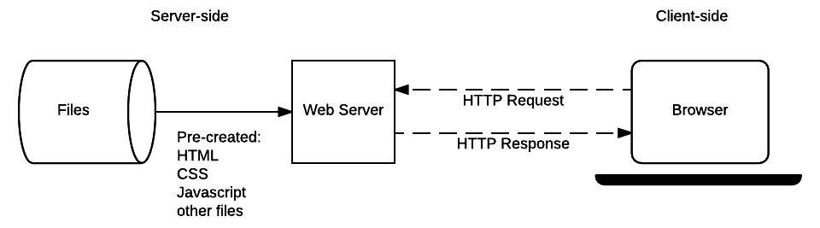
Web Client and Web Server interaction

Slide 29
1.5.1 Role of the server in a web application
1. Hosting and Serving Content:
Web servers store the static files (HTML, CSS, JavaScript, images, etc.) that make up the user interface of a web application.
They deliver these files to users' browsers when requested.
Application servers, on the other hand, handle dynamic content like analytics data, transaction results, and data generated by the application's logic.
2. Managing Client Requests:
Web servers receive HTTP/HTTPS requests from clients (e.g., web browsers).
They process these requests, which can include things like displaying a page, handling form submissions, or making database queries.
They then send back appropriate responses (HTML, JSON, etc.) to the client.

Slide 30
1.5.1 Role of the server in a web application
3. Handling Dynamic Content:
Application servers often work behind web servers to handle the dynamic logic of the application.
They might interact with databases, other services, or business logic to generate content or perform actions.
The results of these interactions are then passed back to the web server for delivery to the client.
4. Maintaining the Application:
Servers are responsible for ensuring the application is running and available to users.
They handle tasks like managing server resources, security, and performance.
They may also be responsible for logging events, monitoring performance, and handling error

Slide 31
1.5.2 Overview of web servers
1) Apache HTTP Server
Overview: Apache HTTP server, often simply called "Apache," is a free and open-source web server and one of the oldest and most widely used web servers. Developed and maintained by the Apache Software Foundation, it has played a crucial role in the growth of the internet.
Key Characteristics:
Open Source: Its source code is freely available, allowing for community-driven development and customization.
Cross-Platform: Apache runs on various operating systems, including Linux, Windows, and macOS.
Modular Architecture: Its functionality can be extended through modules, allowing users to add features like security, caching, and support for different programming languages (PHP, Python, Perl).
Highly Configurable: Apache offers extensive configuration options, providing flexibility for different hosting needs.
Large Community and Extensive Documentation: Due to its long history and popularity, Apache has a vast community providing support and comprehensive documentation.
Common Uses: Hosting websites of all sizes, from personal blogs to large enterprise applications. It's often part of the popular LAMP (Linux, Apache, MySQL, PHP) stack.

Slide 32
1.5.2 Overview of web servers
2) Nginx
Overview: Nginx (pronounced "engine-x") is a free and open-source web server known for its high performance, stability, and low resource consumption. It was initially developed in Russia by Igor Sysoev to address the C10k problem (handling 10,000 concurrent connections efficiently).
Key Characteristics:
High Performance: Nginx utilizes an event-driven, asynchronous architecture, making it very efficient at handling a large number of concurrent connections with a small memory footprint.
Reverse Proxy and Load Balancer: Besides serving static content, Nginx excels as a reverse proxy, distributing client requests to backend servers, and as a load balancer, ensuring efficient resource utilization and high availability.
Growing Popularity: Nginx has gained significant traction and now powers a large percentage of the world's busiest websites.
Versatile: It can also function as a mail proxy server (for IMAP, POP3, SMTP) and a TCP/UDP proxy server.
Common Uses: Serving high-traffic websites and applications, load balancing, reverse proxying, caching, and media streaming. It's often used in modern web development stacks.

Slide 33
1.5.2 Overview of web servers
3) Microsoft IIS (Internet Information Services)
Overview: Internet Information Services (IIS) is a web server created by Microsoft for use with the Windows NT family of operating systems. It's tightly integrated with the Windows environment and supports a wide range of Microsoft technologies.
Key Characteristics:
Windows Integration: IIS works seamlessly with Windows Server and desktop operating systems.
.NET Framework Support: It has native support for the Microsoft .NET framework and ASP.NET, making it a natural choice for applications built with these technologies.
Security Features: IIS includes built-in authentication, authorization, and security features.
Management Tools: It comes with a graphical management tool, IIS Manager, and command-line tools for administration.
Extensibility: IIS can be extended with various modules to add functionality.
Common Uses: Hosting ASP.NET web applications and websites, as well as PHP and other technologies. It's commonly used in environments where Windows Server is the primary operating system.

Slide 34
1.6 Server Side Architecture
Server-side architecture refers to the design and structure of how servers handle requests from clients (like browsers or apps), process them, and send back the appropriate response.
It defines:
How data flows through the server,
How the server interacts with databases,
How business logic is handled,
How security and scaling are managed.

Slide 35
1.6.1 Monolithic
A monolithic server-side architecture is a traditional approach design where an entire application, including its user interface, server-side logic, and database access, is built as a single, cohesive unit.
The user interface, business logic, data access layer, and other services are tightly coupled and deployed as one unit.
Key characteristics:
Single code base: All application components are tightly coupled within one codebase.
Single deployment unit: The entire application is deployed as a single unit.
Centralized database: Typically uses a single database for all application data.
Tight coupling: Components are closely interdependent, making it difficult to isolate failures or scale individual parts.

Slide 36
1.6.1 Monolithic
Advantages:
Simpler development and deployment: Easier to develop, test, and deploy compared to microservices, especially for smaller projects.
Shared resources: Cross-cutting concerns like logging, security, and caching can be easily managed due to shared resources.
Faster development and iteration: Rapid prototyping and development are possible.
Disadvantages:
Difficulty in scaling: Scaling individual parts of the application is challenging as the entire application needs to be deployed.
Single point of failure: If one part of the application fails, it can affect the entire system.
Slow updates and deployments: Changes to the codebase require redeploying the entire application.
Difficult to maintain: Large code base can be challenging to maintain and debug.

Slide 37
1.6.1 Monolithic
Use cases of monolithic architecture:
Small projects: When the application's scope is limited and complexity is manageable.
Proof of concept: For rapid prototyping and iteration.
Rapid development: When quick deployment and development are prioritized.
Small teams: When a small team is developing the application.
Real world example uses of monolithic architecture:
Legacy banking systems
Small e-commerce startups
Building Internal tools or Admin Dashboards

Slide 38
1.6.2 Microservices
A microservices server-side architecture is an approach where an application is structured as a collection of small, independent services that communicate with each other over a network, often using lightweight protocols like HTTP.
Each microservice focuses on a specific business capability and can be developed, deployed, scaled, and maintained independently.
Key Characteristics:
Loosely Coupled: Microservices are designed to be independent, meaning changes in one service don't necessarily require changes in others.
Independent Deployability: Each microservice can be deployed independently, allowing for faster releases and easier scaling of specific services.
Business-Oriented: Microservices are built around business capabilities, making it easier to align technology with business needs.
Well-Defined Interfaces: Services communicate with each other through well-defined interfaces, typically using APIs like RESTful APIs.
Scalability: Individual services can be scaled independently based on their specific load requirements.

Slide 39
1.6.2 Microservices
Advantages:
Improved Scalability: Individual services can be scaled independently to handle varying loads.
Technology Diversity: Teams can choose the best technology stack for each service.
Faster Development Cycles: Smaller, independent teams can develop and deploy services more quickly.
Easier Maintenance: Smaller codebases are easier to understand, maintain, and update.
Increased Resilience: Fault isolation prevents failures in one service from cascading to the entire application.
Better Fault Isolation: Issues in one service are less likely to impact other services.
Easier Adoption of New Technologies: Individual services can adopt new technologies without impacting the entire application.

Slide 40
1.6.2 Microservices
Disadvantages:
Increased Complexity: Managing a distributed system with many services can be complex.
Operational Overhead: Deploying, monitoring, and managing numerous services requires more infrastructure and effort.
Inter-service Communication: Designing and managing communication between services can be challenging (latency, reliability).
Distributed Transactions: Maintaining data consistency across multiple services can be complex.
Testing Challenges: Testing a distributed system with many interacting services can be more difficult.
Monitoring and Debugging: Tracking requests and debugging issues across multiple services can be challenging.

Slide 41
1.6.2 Microservices
Use cases of microservices architecture:
Large, Complex Apps: When building a large and complex application.
Team Diversity: When different teams need to work independently on different parts of the app.
Scalability Needs: When specific parts of the app needs scaling separately (e.g., only the payment service).
Deployment and Updates: When faster deployment and frequent updates is needed without affecting the whole system.
Reliability: When high reliability is expected(if one service fails, others keep running).
Use of multiple technology: When app uses multiple technologies (e.g., Java for one service, Node.js for another).
Fault isolation: When better fault isolation and easier debugging is necessary for each service.

Slide 42
1.6.2 Microservices
Real world example uses of Microservices architecture:
Amazon: Each service (e.g., product catalog, payments, shipping) can be developed, deployed, and scaled independently.
Netflix: To handle millions of users and provide highly available video streaming. Each component—recommendation engine, video transcoding, billing—is a separate service.
Uber, Pathao: Each business function like ride matching, payments, location tracking, and pricing is a microservice.
Spotify: Services like user profile, playlists, search, and recommendations are independently deployed and scaled.

Slide 43
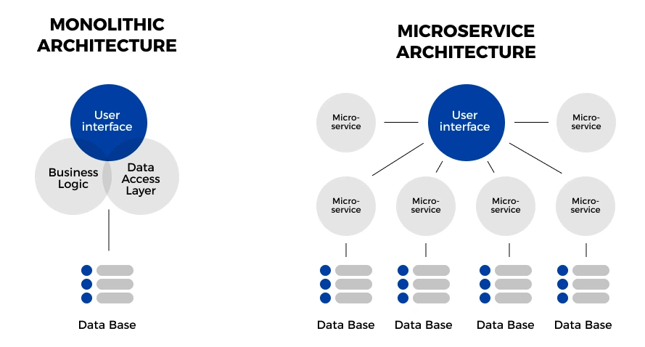
Monolithic vs Microservice Architecture

Slide 44
1.7 Introduction to backend programming languages
A backend programming language is a programming language used to develop the server-side of a web application or software system.
This is the part of the application that users don't directly interact with; instead, it works behind the scenes to handle data, logic, server operations, and communication between the frontend (what the user sees) and the database.

Slide 45
1.7 Introduction to backend programming languages
Python
Python is a high-level, general-purpose programming language.
Python is a versatile and highly readable programming language known for its clear syntax and extensive libraries.
It's used in various fields like web development, data science, machine learning, and software development.
It is very popular among beginners due to its simplicity and ease of learning.

Slide 46
1.7 Introduction to backend programming languages
Python key characteristics:
High-Level Language
Abstracts complex details, making it easier to write and understand code.
Interpreted Language
Executes code line-by-line at runtime, without needing compilation.
Dynamically Typed
No need to declare variable types explicitly; types are inferred at runtime.
Object-Oriented Programming (OOP)
Supports classes, inheritance, encapsulation, and polymorphism.
Readable and Simple Syntax
Emphasizes code readability and uses indentation to define code blocks.
Versatile and Multi-Paradigm
Supports multiple programming paradigms: procedural, object-oriented, and functional.

Slide 47
1.7 Introduction to backend programming languages
Python key characteristics:
Extensive Standard Library
Comes with built-in modules for file handling, networking, regular expressions, math, etc.
Large Ecosystem of Libraries and Frameworks
Includes popular libraries like NumPy, pandas, TensorFlow, Flask, Django, etc.
Cross-Platform Compatibility
Runs on Windows, macOS, Linux, and many other systems without modification.
Open Source and Community Driven
Freely available with strong community support and frequent updates.
Used in Diverse Fields
Applied in web development, data science, machine learning, automation, scripting, IoT, and more.

Slide 48
1.7 Introduction to backend programming languages
Python key characteristics:
Interactive and Portable
Can be used in interactive shells (like Jupyter or REPL) and moved easily between platforms.
Exception Handling
Provides robust tools for managing errors using try, except, finally blocks.
Garbage Collection
Automatic memory management through built-in garbage collection.

Slide 49
1.7 Introduction to backend programming languages
Why Python is used for backend development:
1. Easy to Read and Write
Python has a clean, readable syntax that allows developers to write and maintain code more easily and with fewer bugs.
2. Rich Ecosystem of Frameworks
Powerful backend frameworks like Django (batteries-included) and Flask (lightweight and flexible) speed up development.
These frameworks handle routing, database interaction, templating, security, and more.
3. Versatile and Multi-Purpose
Python is not limited to web development — it’s also widely used in data science, AI, scripting, and automation, making it ideal for multi-functional backend systems.
4. Strong Community and Support
A massive global community means lots of libraries, tutorials, and tools are readily available.
New developers can find help and resources easily.

Slide 50
1.7 Introduction to backend programming languages
Why Python is used for backend development:
5. Built-in Support for Modern Web Features
Excellent support for RESTful APIs, web sockets, and asynchronous programming with tools like FastAPI and aiohttp.
6. Seamless Database Integration
Works well with relational (PostgreSQL, MySQL) and NoSQL (MongoDB, Redis) databases using ORMs like SQLAlchemy or Django’s built-in ORM.
7. Rapid Development
Python’s simplicity speeds up prototyping and development, especially useful for startups and MVPs (Minimum Viable Products).
8. Security Features
Frameworks like Django come with built-in protection against common security threats like SQL injection, XSS, and CSRF.

Slide 51
1.7 Introduction to backend programming languages
Why Python is used for backend development:
9. Scalability
Python applications can scale vertically and horizontally, especially when using asynchronous frameworks or deploying via cloud platforms.
10. Compatible with DevOps and Automation
Python scripts are widely used in backend operations, CI/CD pipelines, and server automation — making it a full-stack backend solution.

Slide 52
1.7 Introduction to backend programming languages
Key Python Frameworks for Backend Development:
Django: A full-featured web framework that handles many backend tasks out of the box.
Flask: A lightweight framework that provides more flexibility and control over the backend.
FastAPI: A high-performance framework designed for building APIs.
Use cases of Python in Backend:
Web application development: Building the server-side logic for web applications.
Data analysis and manipulation: Working with large datasets and performing statistical analysis.
Machine learning and artificial intelligence: Developing and deploying machine learning models.

Slide 53
1.7 Introduction to backend programming languages
PHP
PHP is an acronym for "PHP: Hypertext Preprocessor"
PHP is a server scripting language, and a powerful tool for making dynamic and interactive Web pages.
PHP is a widely-used, free, and efficient alternative to competitors such as Microsoft's ASP.
It is also easy enough to be a beginner's first server side language!

Slide 54
1.7 Introduction to backend programming languages
PHP key characteristics:
Server-Side Scripting
PHP runs on the server and generates dynamic HTML content sent to the browser.
Open Source
Freely available for anyone to use and modify, with strong community support.
Cross-Platform Compatibility
Works seamlessly on different operating systems (Windows, Linux, macOS).
Embedded in HTML
PHP code can be easily inserted into HTML files, allowing smooth integration with front-end design.
Loosely Typed Language
Variables do not require explicit data type declarations, offering flexibility.

Slide 55
1.7 Introduction to backend programming languages
PHP key characteristics:
Fast and Lightweight
Executes scripts quickly, especially with accelerators like OPcache.
Strong Database Support
Integrates with various databases, especially MySQL, PostgreSQL, SQLite, and more.
Extensive Library Support
Offers built-in functions for everything from file handling to image processing.
Object-Oriented Programming (OOP)
Supports classes, inheritance, and interfaces for more organized code.
Error Handling
Provides mechanisms for custom error handling using try-catch blocks and error reporting functions.

Slide 56
1.7 Introduction to backend programming languages
PHP key characteristics:
Secure (with Best Practices)
Includes functions for input validation, data sanitization, and session management (though security depends on implementation).
Wide Adoption
Used by millions of websites; forms the base of major platforms like WordPress, Magento, and Joomla.
Scalable and Extensible
Can be scaled with frameworks, plugins, and integrations; widely used in both small and large-scale applications.
Easy to Learn
Simple syntax and low learning curve, ideal for beginners in web development

Slide 57
1.7 Introduction to backend programming languages
Why PHP is used for backend development:
1. Server-Side Processing
PHP runs on the server to generate dynamic content before it reaches the user's browser.
It can interact with databases, manage sessions, and handle form inputs efficiently.
2. Easy Integration with HTML and Databases
PHP is easily embedded in HTML, making it simple to create dynamic web pages. It works very well with popular databases like MySQL, PostgreSQL, and SQLite.
3. Wide Hosting Support
Almost all web hosting providers support PHP out of the box, often with pre-installed environments.
4. Large Ecosystem and Frameworks
PHP has powerful frameworks like Laravel, Symfony, and CodeIgniter, which speed up development and enforce best practices.

Slide 58
1.7 Introduction to backend programming languages
Why PHP is used for backend development:
5. Fast Development & Deployment
Simpler syntax and built-in web capabilities allow for rapid prototyping and deployment.
Suitable for projects that require fast turnaround.
6. Scalability
Although often used for small and medium sites, PHP can scale for larger systems (e.g., Facebook initially used PHP).
7. Open Source and Cost-Effective
PHP is free, reducing development costs for startups and small businesses.
8. Community and Documentation
PHP has a mature ecosystem with extensive documentation and a vast pool of developers available for support.

Slide 59
1.7 Introduction to backend programming languages
Why PHP is used for backend development:
9. Security Features
Offers built-in functions for hashing, input validation, and secure session handling (though best practices are essential).
10. CMS and E-commerce Integration
Powers popular content management systems like WordPress, Drupal, and Magento, making it a go-to for website and e-commerce backend development.

Slide 60
1.7 Introduction to backend programming languages
Key PHP Frameworks for Backend Development:
Laravel – Most popular; elegant syntax, full-stack features, great for complex apps and APIs.
Symfony – Robust, modular, enterprise-level; ideal for large and scalable systems.
CodeIgniter – Lightweight and fast; great for beginners and simple web apps.
Slim – Minimalist micro-framework for building fast RESTful APIs.
CakePHP – Convention-over-configuration, great for rapid prototyping with built-in tools.
Use cases of PHP in Backend:
Dynamic Websites & Web Apps: Creates interactive websites that change based on user actions and data.
Content Management Systems (CMS): Powers platforms like WordPress for managing website content.
E-commerce Platforms: Builds online stores with features like product catalogs and shopping carts.
APIs (Application Programming Interfaces): Enables communication between different software systems.

Slide 61
1.7 Introduction to backend programming languages
Java
Java is a popular and versatile programming language frequently used for backend development due to its scalability, security features, and large ecosystem.
Its object-oriented nature, platform independence, and robustness make it a suitable choice for building robust and scalable web applications, enterprise systems, and other backend-related projects.

Slide 62
1.7 Introduction to backend programming languages
Java key characteristics:
Object-Oriented Programming (OOP)
Everything in Java is based on classes and objects, supporting inheritance, encapsulation, and polymorphism.
Platform Independence (Write Once, Run Anywhere)
Java code is compiled into bytecode, which runs on the Java Virtual Machine (JVM), allowing it to run on any OS with a JVM.
Strongly Typed and Compiled
Data types are explicitly declared, and code is compiled before execution, which catches many errors at compile time.
Robust and Secure
Features like garbage collection, exception handling, and no pointer access help make Java stable and secure.
Built-in security features (e.g., sandboxing in JVM) support secure backend systems.

Slide 63
1.7 Introduction to backend programming languages
Java key characteristics:
Multithreading Support
Native support for multithreading allows handling of multiple tasks or requests concurrently.
Rich Standard Library
Extensive set of libraries and APIs for networking, I/O, database access, utilities, and more.
Scalability and Performance
Suitable for building high-performance, enterprise-level, scalable backend systems (e.g., banking, telecom).
Widely Used Frameworks
Popular frameworks like Spring, Hibernate, and Java EE streamline backend development.
Garbage Collection
Automatic memory management reduces memory leaks and improves reliability.
Backward Compatibility
Java emphasizes long-term stability, with consistent support for older versions.

Slide 64
1.7 Introduction to backend programming languages
Java key characteristics:
Community and Ecosystem
Massive global developer community, mature tools (e.g., Eclipse, IntelliJ), and rich ecosystem of libraries and integrations.
Used in Enterprise and Web Applications
Trusted by large corporations for backend systems in finance, e-commerce, government, and more.

Slide 65
1.7 Introduction to backend programming languages
Why Java is used for backend development:
1. Platform Independence
Java code runs on any device with a Java Virtual Machine (JVM) — "Write Once, Run Anywhere."
Great for deploying across diverse environments (Linux, Windows, macOS, cloud).
2. Performance and Scalability
Compiled language with optimized performance.
Handles high concurrency and large-scale applications reliably.
Used in banking, telecom, and e-commerce backends that require high availability.
3. Strong OOP and Structured Design
Enforces clean, modular, and reusable code through Object-Oriented Programming principles.

Slide 66
1.7 Introduction to backend programming languages
Why Java is used for backend development:
4. Robust Framework Ecosystem
Frameworks like Spring, Spring Boot, and Hibernate simplify backend tasks like dependency injection, ORM, and microservices.
Java EE provides standardized APIs for web, security, and enterprise features.
5. Multithreading and Concurrency Support
Built-in multithreading enables handling of multiple requests or tasks at the same time.
Critical for building responsive and high-throughput backend systems.
6. Security Features
Java has built-in security mechanisms (sandboxing, access control, bytecode verification).
Trusted for building secure enterprise-grade applications.
7. Mature Ecosystem and Tooling
Rich set of libraries, tools (like IntelliJ IDEA, Eclipse), and extensive documentation.
Backed by a large, experienced developer community.

Slide 67
1.7 Introduction to backend programming languages
Why Java is used for backend development:
8. Enterprise Adoption
Many large corporations use Java in their backend systems due to its long-term support, stability, and enterprise-level capabilities.
9. Cross-Platform Microservices
Java, especially with Spring Boot, is ideal for building RESTful APIs and microservices architectures, deployable on containers (e.g., Docker, Kubernetes).
10. Automatic Memory Management
Java's garbage collector handles memory cleanup, improving reliability and reducing memory leaks.

Slide 68
1.7 Introduction to backend programming languages
Key Java Frameworks for Backend Development:
Spring: A widely used framework for building enterprise-level applications, offering a wide range of features and functionalities.
Struts: A popular framework for building web applications, providing a MVC (Model-View-Controller) architecture.
Grails: A framework for building web applications with a focus on developer productivity, leveraging the Groovy programming language.
Use cases of Java in Backend:
Enterprise Applications: Building large, complex, and mission-critical systems for businesses requiring high reliability and scalability.
Android Mobile Development (Backend Focus): While primarily for frontend, Java is crucial for building the backend services and APIs that Android apps rely on.
Financial Services Applications: Chosen for its security, stability, and concurrency features in building trading platforms, banking systems, and risk management tools.
Microservices Architecture: Well-suited for creating independent, scalable, and maintainable backend services that communicate with each other.

Slide 69
1.8 Understanding MVC architecture
The Model-View-Controller (MVC) architecture is a software design pattern that separates an application into three interconnected components: Model, View, and Controller. This separation of concerns helps organize application logic, data, and presentation, leading to improved maintainability, scalability, and testability.
Model:
Represents the data and business logic of the application.
Handles data storage, retrieval, and manipulation.
Provides the data that the View displays.
View:
Represents the user interface and how the data is presented.
Displays data from the Model.
Receives user input and passes it to the Controller.

Slide 70
1.8 Understanding MVC architecture
Controller:
Acts as the intermediary between the Model and the View.
Receives user input from the View.
Updates the Model based on user input.
Determines which View to display.

Slide 71
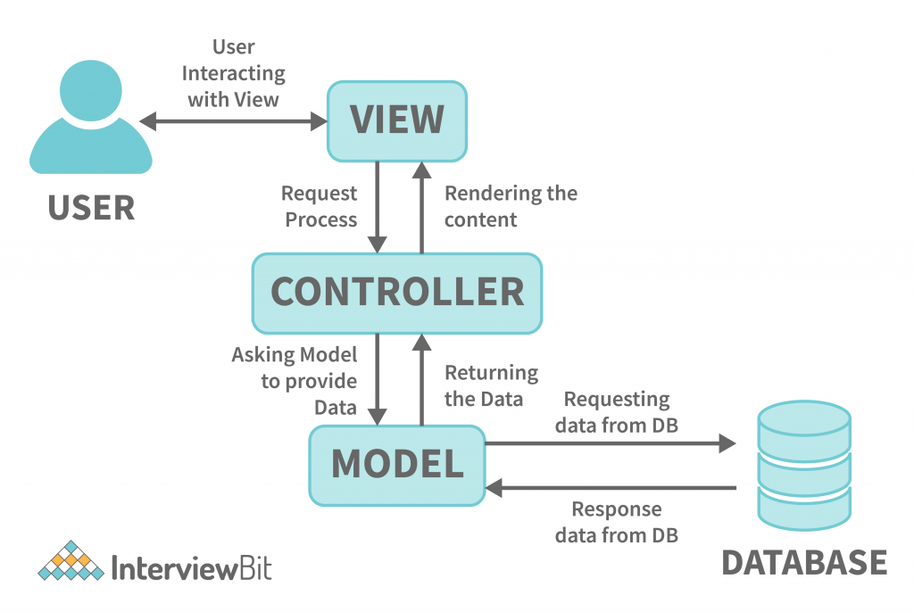
1.8 Understanding MVC architecture

Slide 72
Benefits of MVC architecture
Separation of Concerns: This is the core advantage. MVC clearly divides the application logic into three distinct layers:
Model: Manages the application's data and business logic.
View: Handles the presentation of data to the user.
Controller: Acts as an intermediary, handling user input and updating the Model and View accordingly.
Improved Code Organization: By separating concerns, MVC provides a clear structure to the codebase, making it easier to navigate, manage, and modify different parts of the application without affecting others.
Enhanced Testability: Each component (Model, View, Controller) can be tested independently. This facilitates unit testing and improves the overall robustness and reliability of the application.

Slide 73
Benefits of MVC architecture
Increased Reusability: The Model, containing the business logic and data, can be reused across different Views. Similarly, different Views can be created to present the same data in various formats.
Parallel Development: Different developers can work on the Model, View, and Controller simultaneously, as they are independent of each other. This can significantly speed up the development process, especially for larger teams.
Easier Maintenance: Changes or bug fixes in one part of the application are less likely to affect other parts due to the separation of concerns. This makes maintenance and updates simpler and less error-prone.
Flexibility and Adaptability: MVC allows for easier modification of the user interface (View) without altering the underlying data logic (Model) and vice versa. This makes the application more adaptable to changing requirements and different presentation formats.
Support for Multiple Views: The same data (Model) can be presented to the user through different Views (e.g., a table, a chart, a mobile view).
SEO-Friendly URLs (for web applications): MVC frameworks often facilitate the creation of clean and RESTful URLs, which are beneficial for search engine optimization.

Slide 74
Benefits of MVC architecture
Support for Multiple Views: The same data (Model) can be presented to the user through different Views (e.g., a table, a chart, a mobile view).
SEO-Friendly URLs (for web applications): MVC frameworks often facilitate the creation of clean and RESTful URLs, which are beneficial for search engine optimization.

Slide 75
Example
Imagine a Online Shopping Platform:
A user interacts with the UI (view) and clicks "Add to Cart" for a product.
The controller receives the event and interacts with the model to add the product to the user's cart.
The model updates the data (e.g., adds the product to the database).
The controller tells the view to refresh the shopping cart display, showing the updated list of items.

Slide 76
